Slide 1

Spike Sorting on the High Performance Computer (HPC)
Created by: Adel Haddad
Created for: Imperial Dragonfly Lab (Dr Huai-Ti Lin)

Slide 2
Review of Spike Sorting
15 mins
Jai Bhagat and Caroline Moore-Kochlacs, MIT Center for Brains, Minds and Machines (CBMM) , https://youtu.be/0eP8CCxAWLo

Slide 3
Neuron 3
Neuron 2
Neuron 1
Notes:
We are implanting an electrode in an extracellular space – and we will inevitably record from multiple neurons simply due to the size of our electrode
Spike sorting aims to identify what neural signal came from which neuron

Slide 4
Electrode
Electrode Signal (Extracellular Potential)
Voltage
Time
Notes:
We are implanting an electrode in an extracellular space – and we will inevitably record from multiple neurons simply due to the size of our electrode
Spike sorting aims to identify what neural signal came from which neuron

Slide 5
Electrode
Electrode Signal (Extracellular Potential)
Voltage
Time
Notes:
We are implanting an electrode in an extracellular space – and we will inevitably record from multiple neurons simply due to the size of our electrode
Spike sorting aims to identify what neural signal came from which neuron

Slide 6
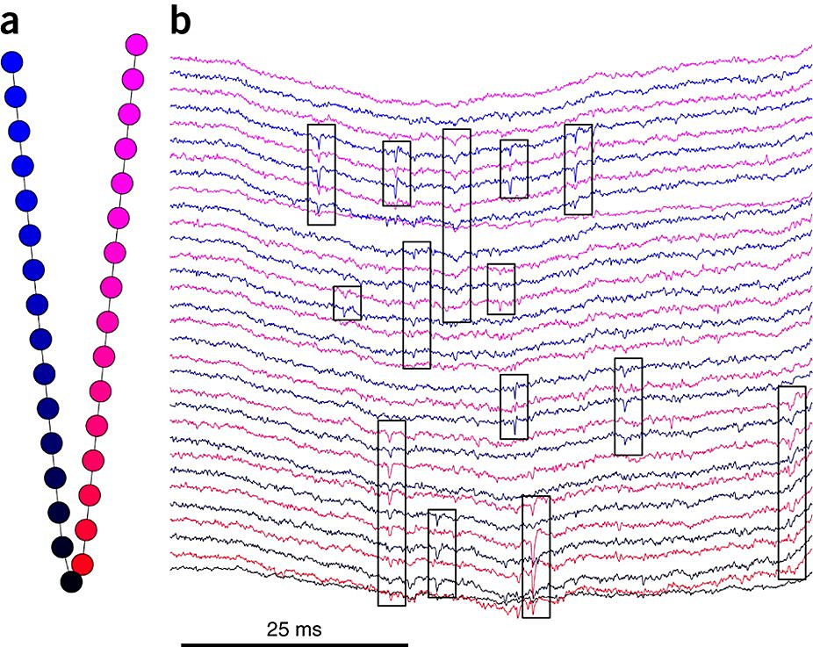
Scales badly as you use multiple recording sites
Spike sorting for large, dense electrode arrays Cyrille Rossant, Kenneth D Harris et al. - Nature Neuroscience volume 19, pages 634–641 (2016)
Notes:
Black boxes highlight potential waveforms
We can see how they span multiple electrode sites

Slide 7
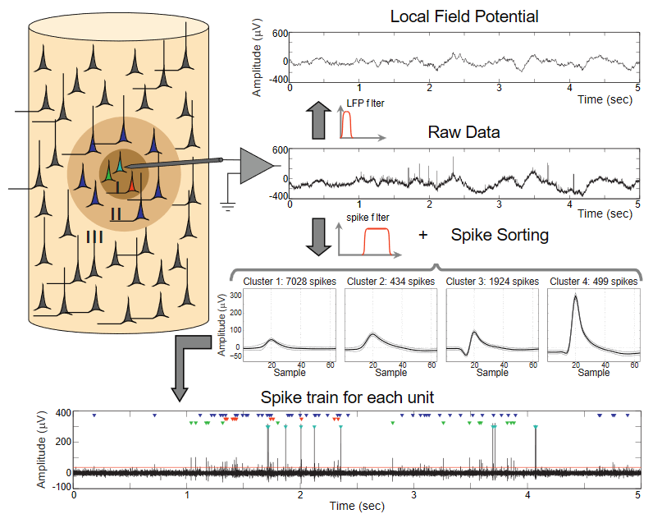
Past, present and future of spike sorting techniques - H.G. Rey et al. - Brain Research Bulletin 119 pages 106–117(2015)
Notes:
Figure 1 from source
Note: I, II, III in image – and colour coding , two neurons same colour can’t distinguish
Filtering typically done digitally
LFP – Black neurons in III, the background neural activity you can say – classified as noise (hence filtered out)
Spike filtering typically bandpass between 300Hz & 3kHz
Spike Sorting here taken as a black box
Spike Train – we can see threshold has red line – coloured triangles are associated with the neurons in the diagram
NOTE: The paper has multiplied amplitudes by -1, hence why we get a positive peak even though it is extracellular

Slide 8
Why are we interested in Individual Neuron Activity?
Neurons “Rate”/“Timing” of firing can encode information
Different neurons can be encoding different information (even if in a similar location)
The co-ordination of neuron spike activity can also give us additional information

Slide 9
Sorting
Classification Problem
Notes:
Features can be used independently, and depend on the spikes you are using

Slide 10
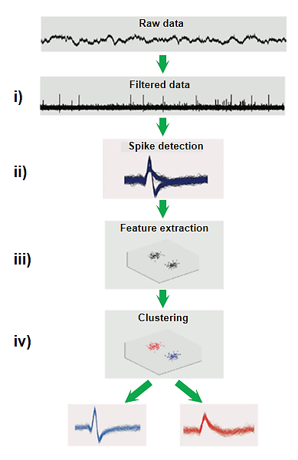
Clustering
Past, present and future of spike sorting techniques - H.G. Rey et al. - Brain Research Bulletin 119 pages 106–117(2015)
e.g. Thresholding
Sorting
Notes:
Figure 2 from source
Filtering removes variations so we can easily detect spike events
Sorting – separate waveform/spikes from raw data
Clustering – grouping spike events
Spike detection typically done by done form of thresholding – in template matching – a template is formed from thresholded data but then is run on the entire filtered data (not just detected thresholded spikes) – then taking a certain number of samples to either side of the spike
Feature extraction is plotting in in a multidimensional space – to make the clustering easier – i.e. more distinct groups are formed
1 Cluster is all the spikes associated to one neuron (ideally)

Slide 11
Sorting
Classification Problem
Features you can use
Waveform Properties
Amplitude (e.g. Peak, Trough, Crest-Trough), Rise Slope, Fall Slope, Width, Energy/Power/RMS …
Shape
Template Matching
Notes:
Features can be used independently, and depend on the spikes you are using

Slide 12
Notes:
LHS: Constant variation about waveform & relatively low variations
RHS: Large variation on tails of waveform, but peak is slightly tighter, especially around slopes
Can run this through the entire data, or only at spike events – see if it lies within deviation or if you can scale template to match

Slide 13
Sorting
Classification Problem
Features you can use
Waveform Properties
Amplitude (e.g. Peak, Trough, Crest-Trough), Rise Slope, Fall Slope, Width, Energy/Power/RMS …
Shape
Template Matching
PCA – Principle Component Analysis
Notes:
Features can be used independently, and depend on the spikes you are using

Slide 14
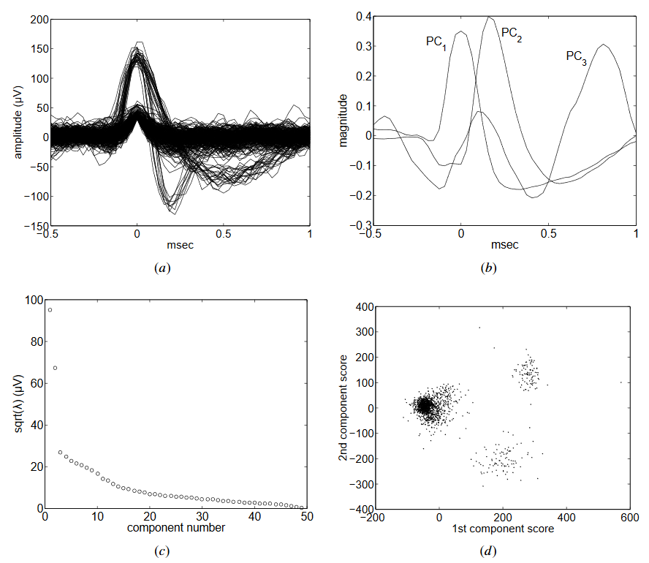
A review of methods for spike sorting: the detection and classification of neural action potentials - Michael S Lewicki – Network: Computation in Neural Systems Pages R53-R78 (1998)
Notes:
Figure 7 from source
All the spikes waveforms that have been detected
Each spike waveform is discretized into a series of points
We can identify around 3 uniquely shaped waveforms
Some Principle Components (Coefficients) have been generated here – one coefficient for each point in the waveform data
The magnitudes chosen for the PCs are done according to the variance in all waveforms at that time point – so we are trying to capture the most variance in the data
These components apply an element wise multiplication with the waveforms, then all the results of the multiplication are added together to form a score
This score reduces the dimensionality of our data from 32 samples to, in this case, the scores for each of the 3 PC
Here it is showing the standard deviation of the scores for a given waveform as you increase the number of PCs
so it just shows that as you try and make more, the deviation between them becomes smaller – as they become more similar
With a few PCs they each can be sufficiently different to cause distinctly different scores
Plotting the scores of PC1 and PC2 of the same graph for all of the waveforms in (a) shows clear clusters
Agreeing with the idea that there are 3 waveforms
Large cluster is actually noise – as low (close to 0) in both PC spaces

Slide 15
PC can give us a rough template

Slide 16
Sorting
Classification Problem
Features you can use
Waveform Properties
Amplitude (e.g. Peak, Trough, Crest-Trough), Rise Slope, Fall Slope, Width, Energy/Power/RMS …
Shape
Template Matching
PCA
Discrete Wavelet Transform
Notes:
Features can be used independently, and depend on the spikes you are using

Slide 17
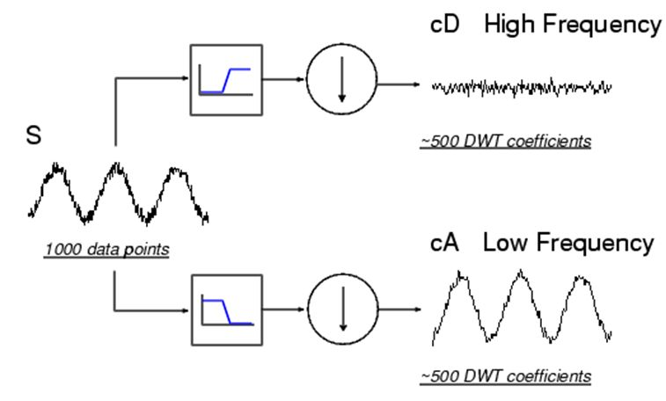
Enrique Nava, University of Málaga (Spain) Brasov, July 2006

Slide 18
Voltage – Time (Samples)
cA
idwt()
[cA,cD] = dwt(x, ..)
cA,cD idwt()
idwt()
cD
Notes:
These two halves are concatenated together for the ‘complete transform’
Can do inverse to reconstruct signal
However, not shift invariant – so not ideal for all comparisons
How do we then use this – we apply dimensionality reduction onto cA typically.
If we do the dwt() for all the waveforms – we can take the average cA, then pick a few elements of the transforms that has the most variance
Different waveforms can have elements chosen of different location and/or value
Then you have a feature space based on the wavelet transform

Slide 19
Sorting
Classification Problem
Features you can use
Waveform Properties
Amplitude (e.g. Peak, Trough, Crest-Trough), Rise Slope, Fall Slope, Width, Energy/Power/RMS …
Shape
Template Matching
PCA
Discrete Wavelet Transform
Biological Boundary Conditions
E.g. Interspike interval (Refractory Period)
Notes:
Features can be used independently, and depend on the spikes you are using
Biological boundary conditions are usually not considered, but are provided to the user as a way of assessing the quality of the sorting / clustering

Slide 20
Clustering
Putting extracted spikes (sorted data) into a minimal number of groups, that (ideally) represent individual neurons.
Sorting implementation typically means this happens to some degree while sorting
Manual
Manually Identify clusters in the Feature Space
Automatic
Algorithmically identify clusters in the Feature Space, e.g. k-means, Fuzzy C-Means
Combination
Algorithmically identification followed my user review of clustering – enabling ‘merging’ and ‘splitting’ of clusters
Notes:
Sorting is more like puuling out the spikes from your data
Typically clustering happens simultaneous due to the nature of the sorting – e.g. everything associated with a single template in template matching can be considered a cluster

Slide 21
Where Automatic Clustering can Fail
Bursting Spikes
Spikes that come in quick succession and rapidly decrease with amplitude – they can merge with another neuron whose spike has a lower amplitude in general (or the noise cluster that is typically around 0,0 in Feature Space)
Electrode Drift
During the acquisition the signal starts getting weaker/stronger – the cluster will start spreading in feature space (same problem as above)
Notes:
In general can be very good and don’t have subject bias
Phy GUI images should hopefully clarify

Slide 22
Simultaneous spike events “Overlapping Spikes”
Multi-Unit-Activity (MUA) – two spikes from different neurons that are recorded at the same/similar time instance can be superposed
Would often be classified as a new cluster
Hence multiple recording sites
Some approaches can distinguish the two waveforms that can contribute to the ‘Overlapping Spike’
Preprint [Kilosort: realtime spike-sorting for extracellular electrophysiology with hundreds of channels – Pachitariu et al. – bioRxiv dx.doi.org/10.1101/061481 (2016). ]
Actual Paper [Fast and accurate spike sorting of high-channel count probes with Kilosort – Pachitariu et al. – Advances In Neural Information Processing Systems. 4448-4456]

Slide 23
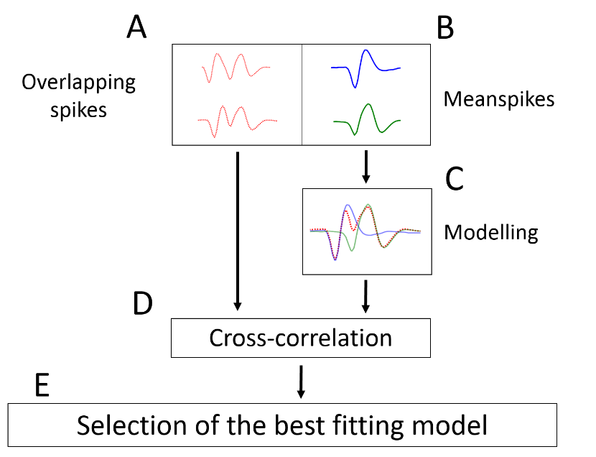
Simultaneous spike events “Overlapping Spikes”
Spike sorting: the overlapping spikes challenge – Inga Sauer et al. – Current Directions in Biomedical Engineering; 1:42–45 (2015)

Slide 24
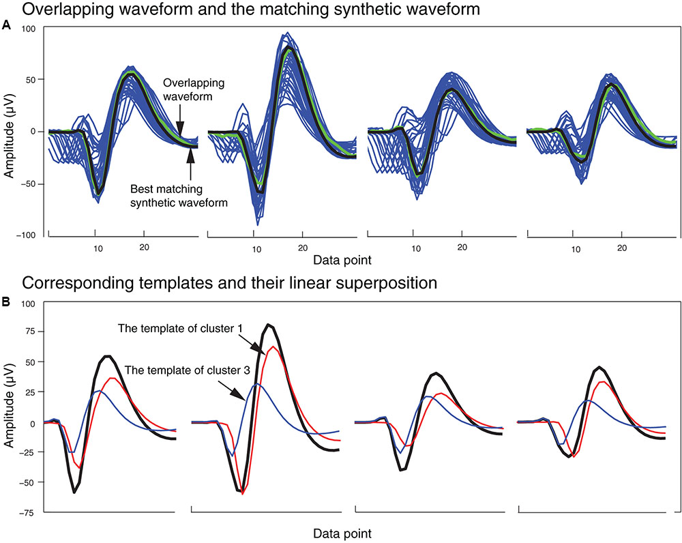
Sorting Overlapping Spike Waveforms from Electrode and Tetrode Recordings – Mokri et al. - Frontiers in Neuroinformatics Vol. 11 (2017)
Notes:
Figure 5
B – varying different superpositions and scaling of templates (not time shifting in this case)
The synthetic waveforms (blue) clustered with one overlapping waveform (green) are shown with the best-matched synthetic waveform highlighted in black.
The template waveforms (blue and red) that generated the synthetic waveform (black) shown in (A). The cluster numbers refer to the cluster numbers in Figure 2B.

Slide 25
Is any of this real?
How do we know these are actually neuronal spiking?
We have ‘Ground Truth Data’ where neurons have been individually patch clamped while extracellular recordings have been taken
Then you can associate spike events timings from both intracellular and the extracellular recordings to confirm that your cluster has true spikes
Notes:
Youtube video goes into a bit more detail

Slide 26
Spike Sorting Programs

Slide 27
MClust
Matlab, allows you to see many feature spaces & import sorting data from other programs
Manual
KlustaKwik
Depreceated, automatic spike sorting, PCA
GUI for manual clustering
KiloSort
Made by creators of KlustaKwik, automatic, template matching
A single template will have a template waveform for each channel of your data
GUI for manual clustering
GPU capable, for much faster performance – 29 mins vs 10 days [128 channel]

Slide 28
HPC Workflow (with KiloSort)
10 mins
Demonstration 5-10mins

Slide 29
Edit the CPU job script
CPU
Generate Code to Run
Upload Code to HPC Server
CPU or GPU
Make sure code is HPC compatible
Submit the job to the HPC queue
Check & Download results
Edit the GPU job script
GPU

Slide 30
File Organisation

Slide 31
HPC Temporary Directory
Your Files & Scripts
$TMPDIR
Script A
Folder A
Script B
File
Your Root Directory
$HOME
XYZ
Your Folder
Script A
Folder A
Script B
File
Your Files & Scripts

Slide 32
HPC Temporary Directory
Your Files & Scripts
$TMPDIR
Script A
Folder A
Script B
File
Output
Your Root Directory
$HOME
XYZ
$WORK
Unique Folder
Script A
Folder A
Script B
File
Output
$HOME
XYZ
Your Folder
Script A
Folder A
Script B
File
Output
$WORK
Your Files & Scripts
Notes:
http://www.imperial.ac.uk/admin-services/ict/self-service/research-support/rcs/support/getting-started/data-management/

Slide 33
Setting Up Environment

Slide 34
Recommended software
Windows
Mobaxterm
Putty & WinSCP
Mac
Putty & CyberDuck
College Network
MobaXterm & \\rds.imperial.ac.uk\RDS (networked drive)
Terminal | SFTP Browser
MobaXterm
Putty | WinSCP, CyberDuck
Notes:
Networked drive is just like your H drive – although you might need to add it in manually

Slide 35
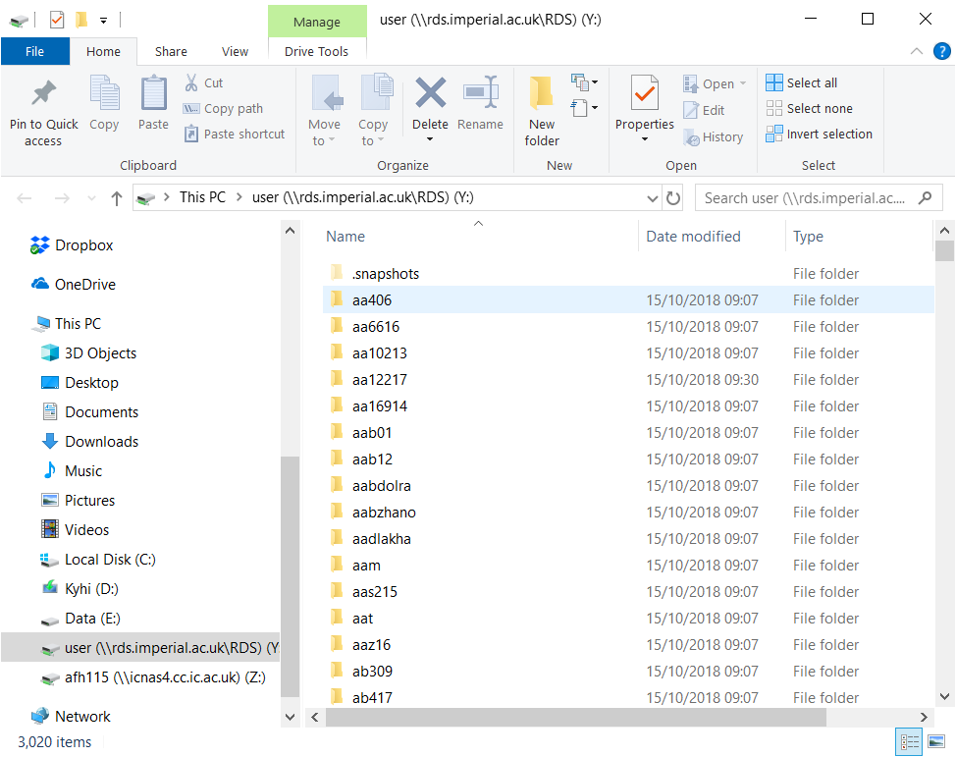
Networked Drive
http://www.imperial.ac.uk/admin-services/ict/self-service/research-support/rcs/support/getting-started/data-management/
Location: \\rds.imperial.ac.uk\RDS\user\ NOT \\rds.imperial.ac.uk\RDS\afh115\
(Windows), (macOS).
Have read/write access to your home and ephemeral spaces, along with any projects you are a member of.
If you are off-site you must first connect to the OpenVPN VPN.

Slide 36
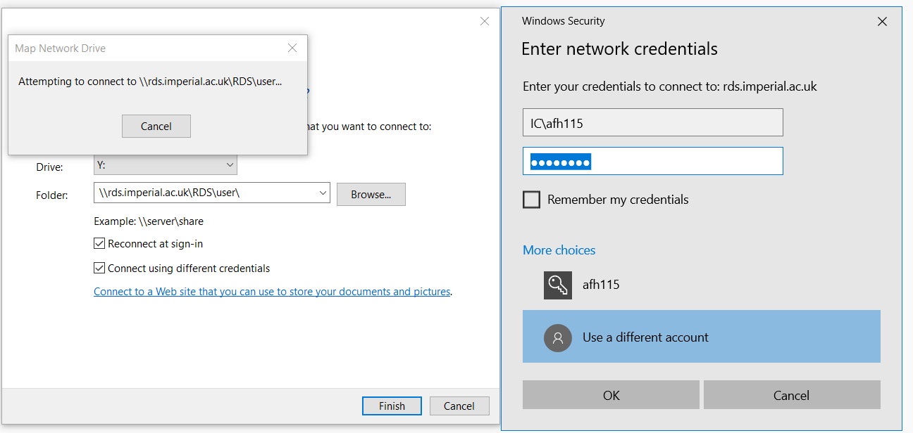

Slide 37
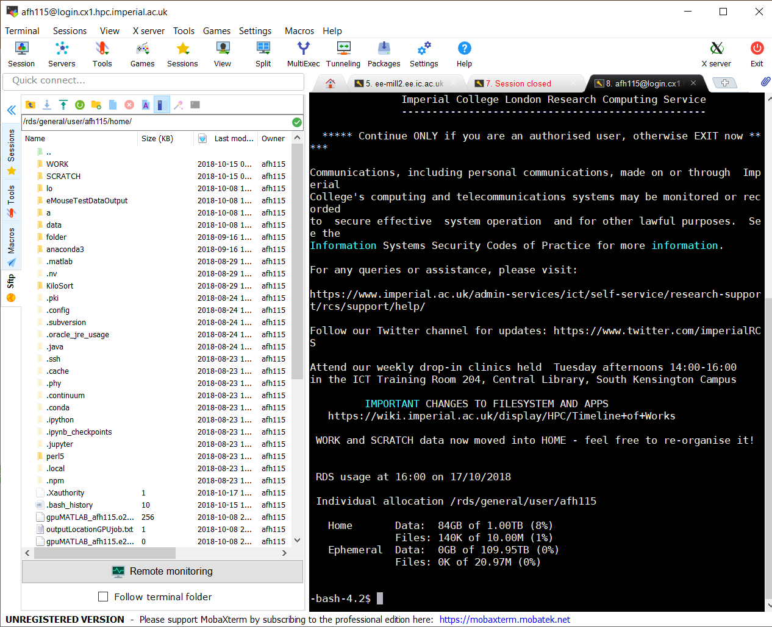
Uploading and Downloading files
We can use a SFTP browser to access files in the HPC server
Terminal and File browser in same place
Notes:
Move Up Folder, Download, Upload, Refresh File List, New Folder, New File, Delete, …, …, …, …

Slide 38
On first run
Use the HPC-setup.zip
Contains all the files for spike sorting, additionally sets ups python (via anaconda environment), MATLAB and some, other useful things like GitHub
Extract using terminal command : ‘unzip HPC-setup.zip’
Or if using the network drive can extract it directly
Upon extracting this folder you should be able to run the included script files, the folder structure is also designed to work with the scripts
bash setupHPC.sh

Slide 39
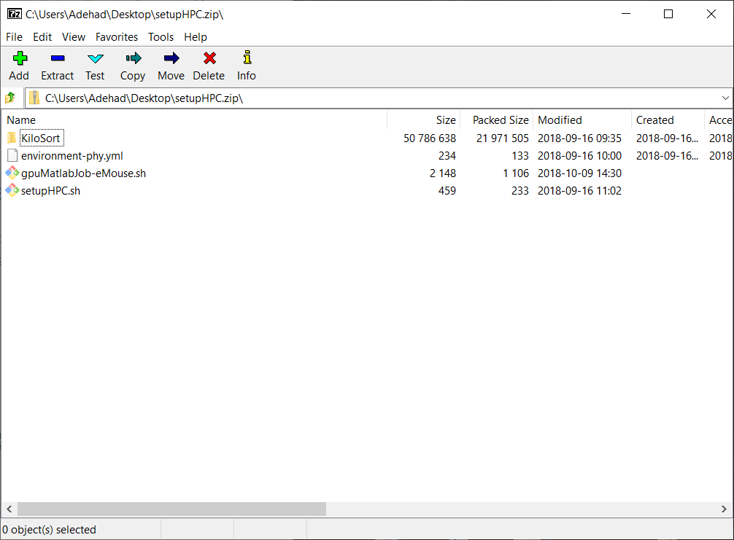

Slide 40
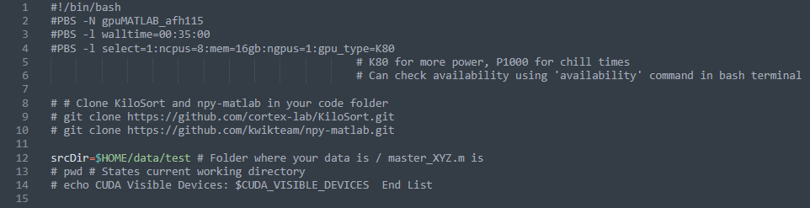
Editing the job script 1/3
The CPU and GPU job scripts are largely similar
‘availability’
The main difference of GPU script can be seen in:
line 5, here is where we specify the GPU we want to use
Module load of Cuda (MATLAB specific version)
Notes:
Go through the initial setup lines of code
$HOME = ??? Explain it /rds/general/user/afh115/home/
$ sign is when we use a variable defined, $HOME is define automatically by ICT (“environment variable”) – so you do not need to explicity define it:
e.g. If you wanted to do it manually: HOME = /rds/general/user/afh115/home/
How do you decide how long ? Over estimate, then once you know how fast you can give a shorter time
Availability
Red – important to understanding script function
Yellow – what you need to edit for your data
srcDir – location of the folder (‘Your Folder’ in File Organisation Slides) – which contains your scripts and data files

Slide 41
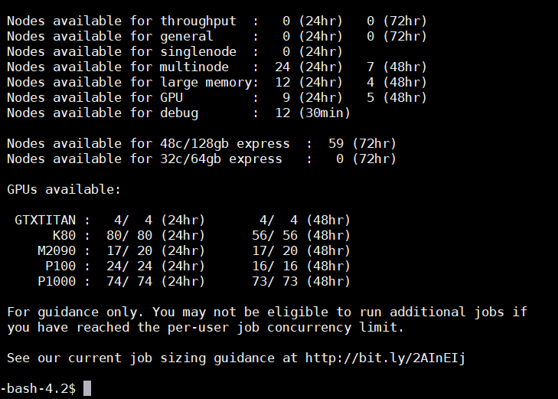
Editing the job script 1/3
The CPU and GPU job scripts are largely similar
‘availability’
The main difference of GPU script can be seen in:
line 5, here is where we specify the GPU we want to use
Module load of Cuda (MATLAB specific version)
Notes:
24hr/72hr is the maximum wall time
Depending on the parameters of your job script you will be allocated into different ‘nodes’

Slide 42
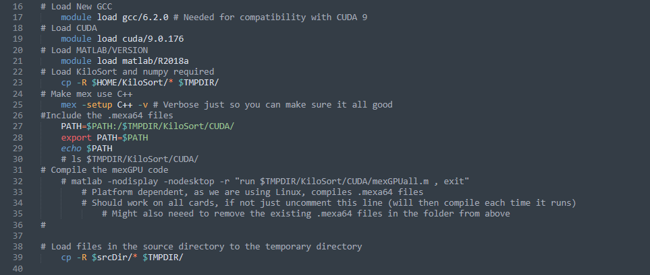
Editing the job script 2/3
Load programs required
Copy files/functions to the $TMPDIR
Add functions to PATH
Notes:
You start by loading in all the programs you need – e.g. Matlab
In this case we are also copying a ‘KiloSort’ directory – which has a bunch of scripts needed to run KiloSort
For good measure we add these some of the precompiled KiloSort GPU scripts to the PATH (so in theory all scripts should be able to see the contents of the KiloSort directory)
We end by copying the contents of srcDir into the ‘HPC Temporary Directory’

Slide 43
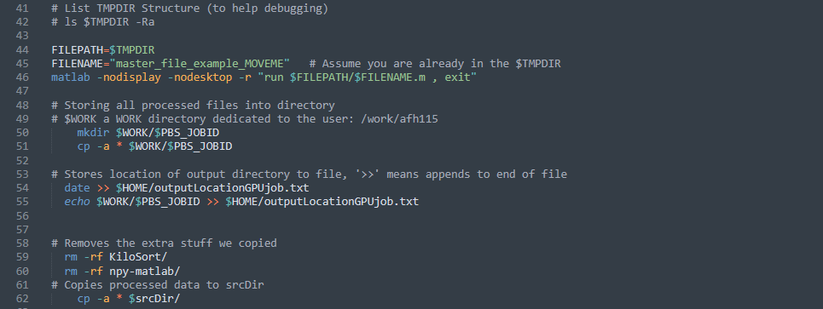
Editing the job script 3/3
FILEPATH to your script, relative to the $TMPDIR
FILENAME of your script once in the path
Notes:
We are now telling the HPC what script to run:
This is from the perspective of the HPC Temp Directory
The default filepath is $TMPDIR, but if you are storing your scripts in a different folder (within the contents of srcDir) you should refule the path further
NOTE: This path variable should not end with the folder separator – you can see in line 46 that it is added for you
The filename is the name of the script you are running
We store the contents of the TMPDIR into a WORK folder ($WORK = /rds/general/user/afh115/home/WORK/ in my case ). This acts as a backup for the output.
NOTE: There was a recent HPC update which may mean that the $WORK variable does not exist by default, then you would need to define it just like we did the srcDir in Part 1/3
We also store the location of the output and date into a text file, to help you keep track of what job ran when.
Finally we remove extra files (rm –rf mean we are removing folders), from the TMPDIR.
We then copy the contents of TMPDIR to the original location where our scripts were located. This is so that it feels as if you ran the script on your own machine instead of the HPC – where the output is in the same location you expect it to be.

Slide 44
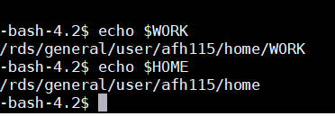
$WORK no longer there?
Recent updates mean that you might need to manually define the variable $WORK in your script.
The same way we defined $srcDir.
Notes:
\WORK folder ($WORK = /rds/general/user/afh115/home/WORK/ in my case ). This acts as a backup for the output.
NOTE: There was a recent HPC update which may mean that the $WORK variable does not exist by default, then you would need to define it just like we did the srcDir in Part 1/3

Slide 45
Make sure the code is HPC compatible
Important to realise that the HPC creates a different ‘user’, this user’s home folder (root directory) is $TMPDIR
Use the job script to copy the files needed for your code – in the same way that your code wants them
If your code is looking for a folder called ‘Functions’, you need to copy that folder to where your script can see it.
Use Relative paths – e.g. ‘ ../ ’ to go up a directory
NOTE: Windows uses ‘..\’, but the HPC is Linux based so ‘../’ !!!!

Slide 46
Submit the job to the HPC Queue
qsub <scriptName>
E.g. qsub gpuMatlabJob.sh

Slide 47
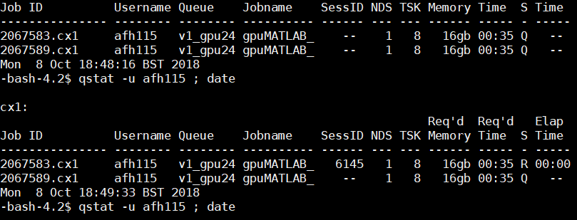
Monitor the HPC job
qstat – u <username> ; date
E.g. qstat –u afh115 ; date
Terminate job:
qdel <job_ID]
E.g. qdel 2067583.cx1

Slide 48
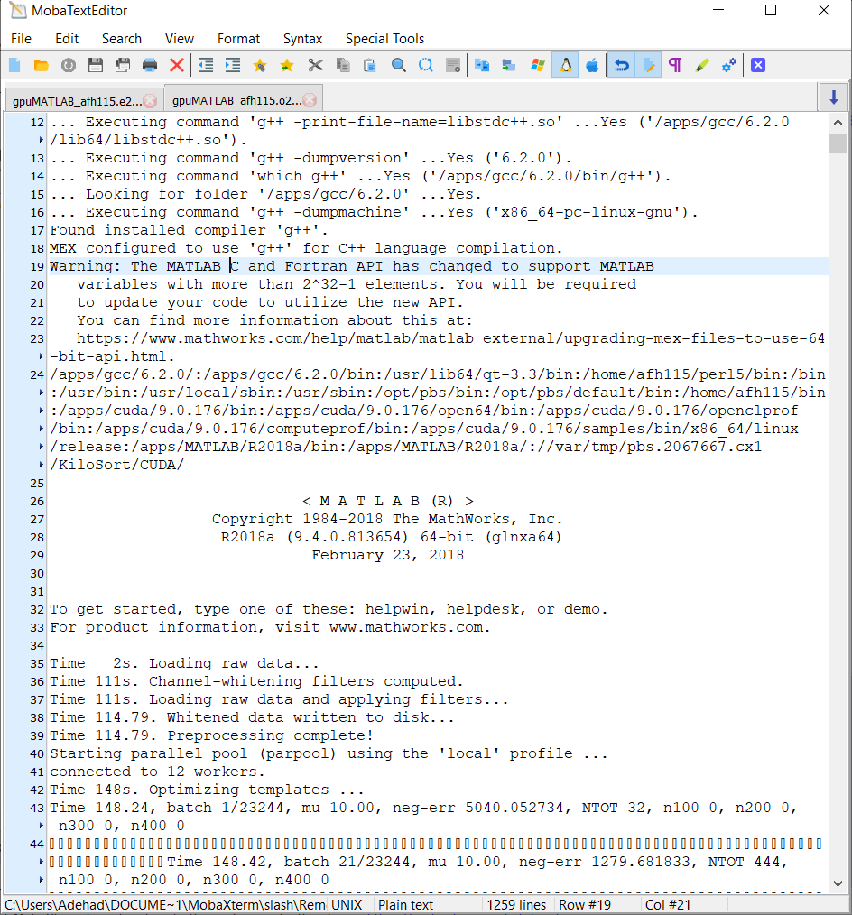
Check & Download Results
Output and Error files are generated by the HPC
Output file:
<job_name>.oXXXXXX

Slide 49
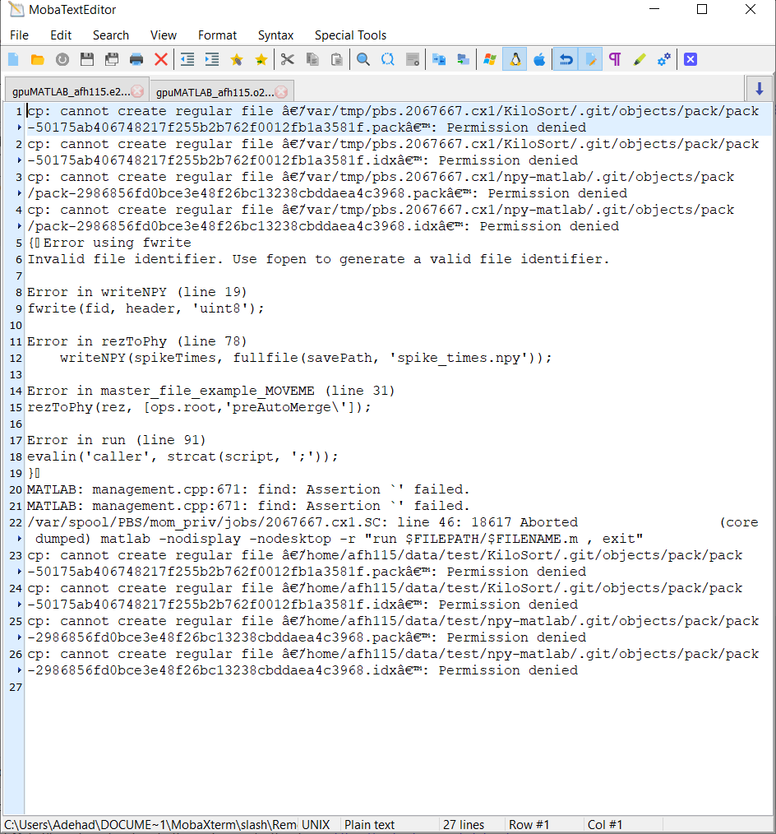
Check & Download Results
Output and Error files are generated by the HPC
Output file:
<job_name>.oXXXXXX
Error file:
<job_name>.eXXXXXX

Slide 50
Demonstration
10-15 mins
+ Phy GUI run through while we wait
Notes:
Walk through the use of the eMouse Data

Slide 51
Phy GUI
5 mins
Notes:
Walk through the use of the eMouse Data

Slide 52
Manual Clustering Guide
https://github.com/kwikteam/phy-contrib/blob/master/docs/template-gui.md

Slide 53
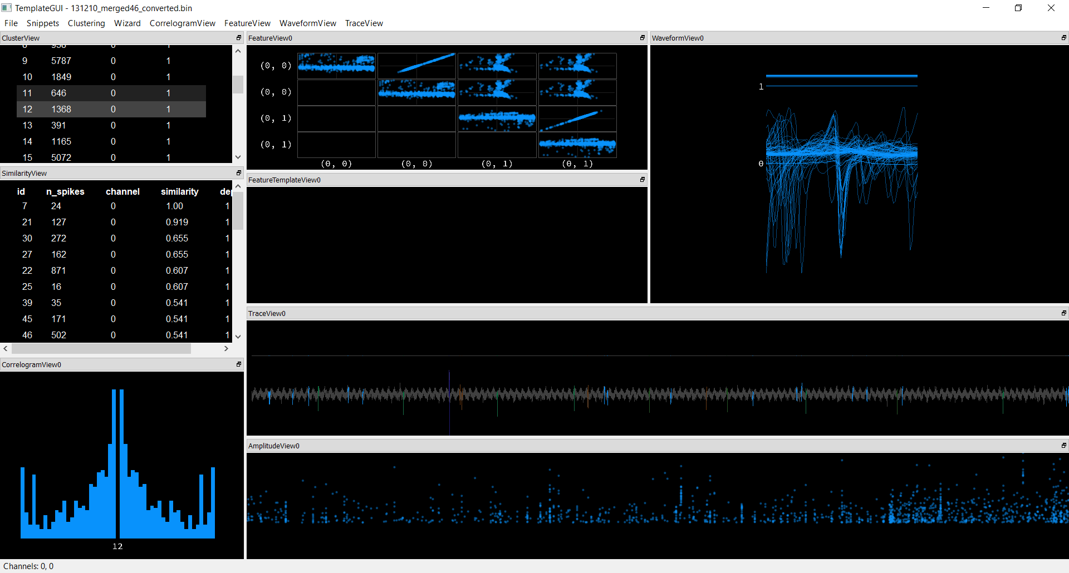

Slide 55
TraceView
Raw Data Trace for each Channel
Here we are looking at a single channel recording, with 3 dummy channels with a fixed value (1)

Slide 57
AmplitudeView
Displays the scaling of the template for each spike recorded
X-axis is the time
spikes events are binned, hence why it looks like multiple spikes occur at the same time
Drift can be seen in this view

Slide 59
CorrelogramView
CorrelogramView –
One Cluster Selected – Time interval between spikes, positive and negative (“auto-correlograms of cluster spike train”)
Multiple Clusters Selected – Diagonal shows each cluster’s “auto-correlogram”, remaining show “cross-correlogram” between cluster spike trains.
Can tell you if one cluster’s spikes occur before the other selected
Window of 50ms, Bin size of 1ms.
These can both be adjusted using the CorrelogramView dropdown menu.

Slide 61
ClusterView & Similarity View
ClusterView, allows you to select a cluster to view
SimilarityView allows you to select additional clusters to compare to the cluster selected in ClusterView
Supports Ctrl+Left Click or Ctrl+Shift+Left Click

Slide 63
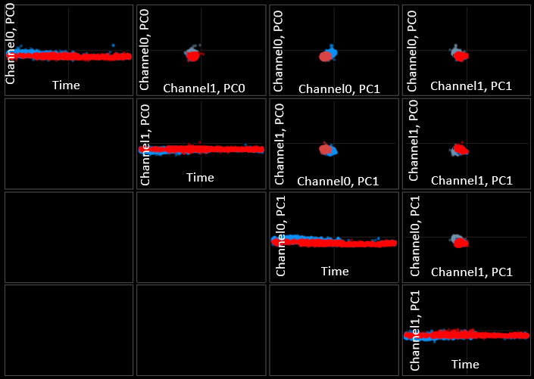
FeatureView & FeatureTemplateView
FeatureView – allows you to compare PC0 and PC1 of any two channels, at each spike time (dots) – image on right is using Channel 0 and 1
In the case of single channel recordings, you can set both to the channel with your signal i.e. Channel 0
FeatureTemplateView allows you to see how the templates for the selected clusters compare in a ‘feature space’
Projecting the spikes from each cluster onto the template space
Notes:
FeatureTemplateView - https://github.com/cortex-lab/KiloSort/issues/143

Slide 64
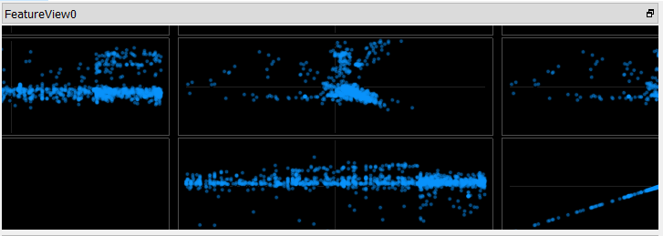
FeatureView & FeatureTemplateView

Slide 65
Split Example

Slide 66
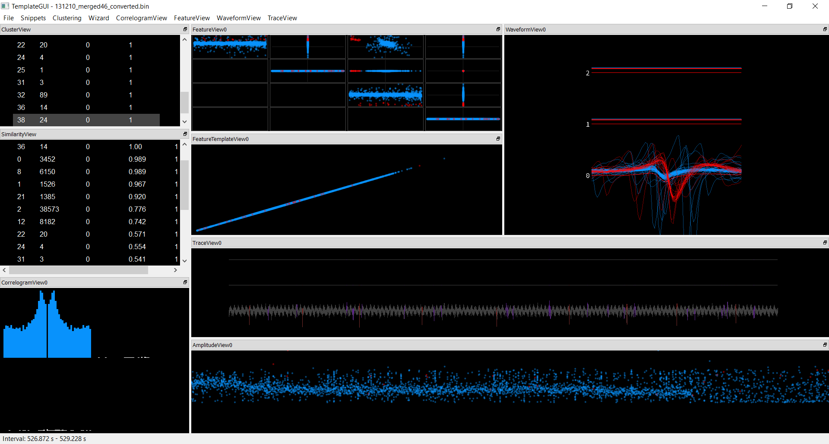
Notes:
Split Example
Bottom Left – Interspike Interval Correlelogram
Bottom Amplitude Scaling Required for the Templated
Feature Corelleogram – close to zero due to small number of spikes and poor total correlation
Selecting using CTRL + LEFT CLICK on FeatureView (Explained in more detail in the website)

Slide 67
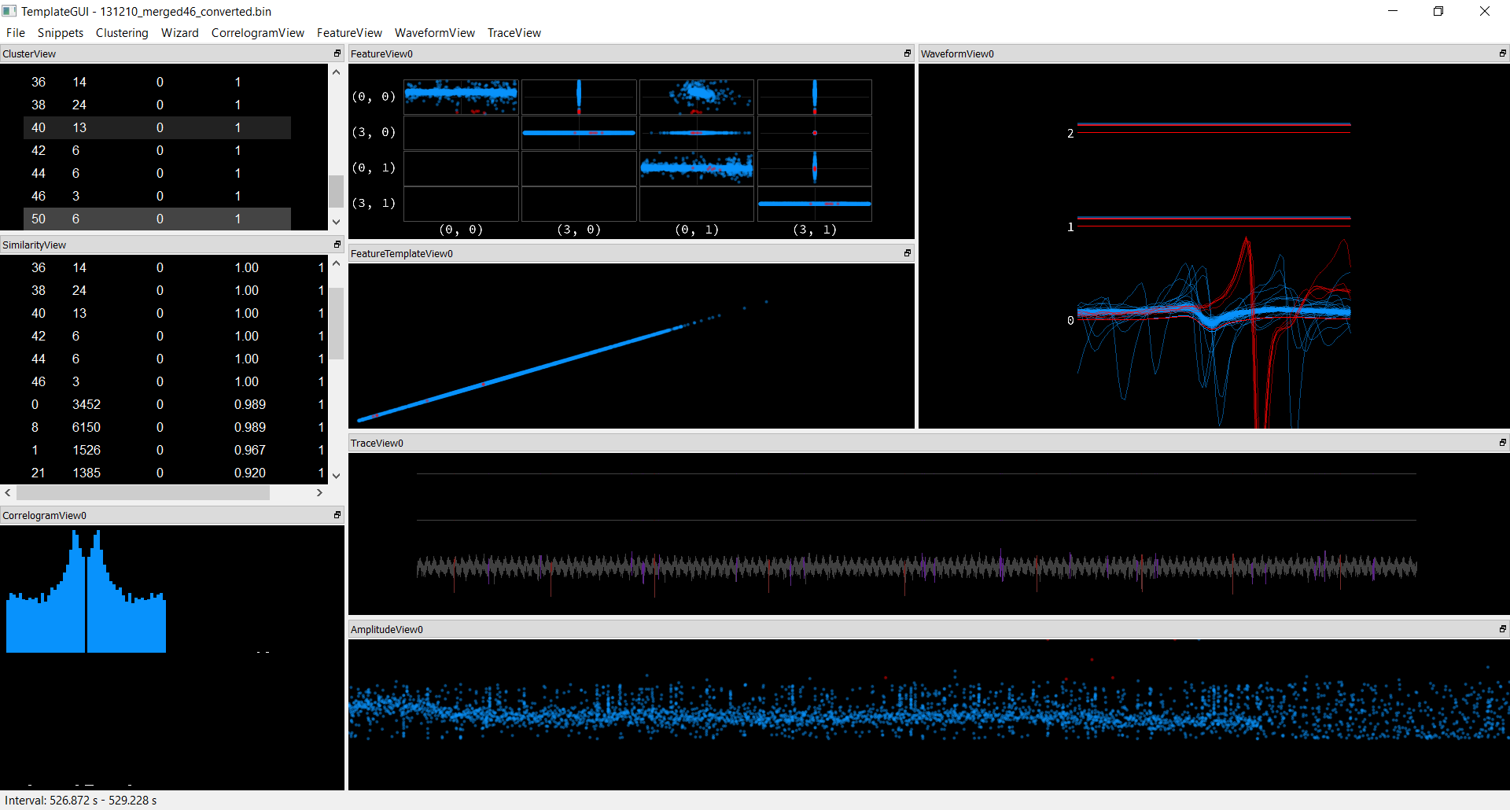
Notes:
Split Example 2

Slide 68
Merge Example

Slide 69
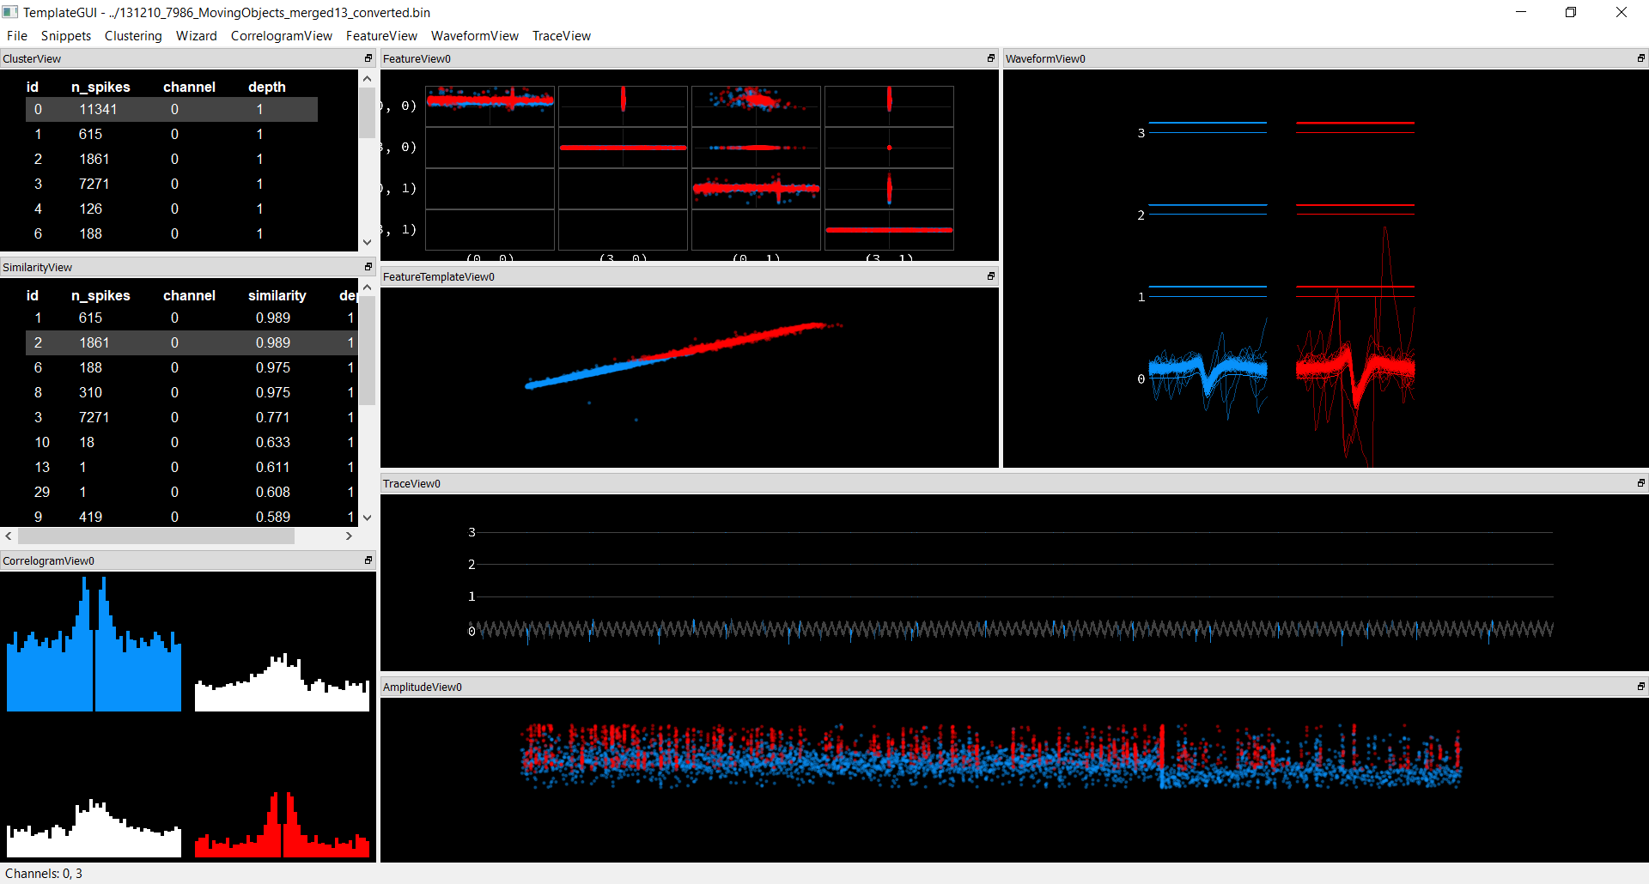
Notes:
Merge Example
Possibly, changes could have been from recording experiment
Note: CorrelogramView top right shows how the blue spike typically occurs before the red spike

Slide 70
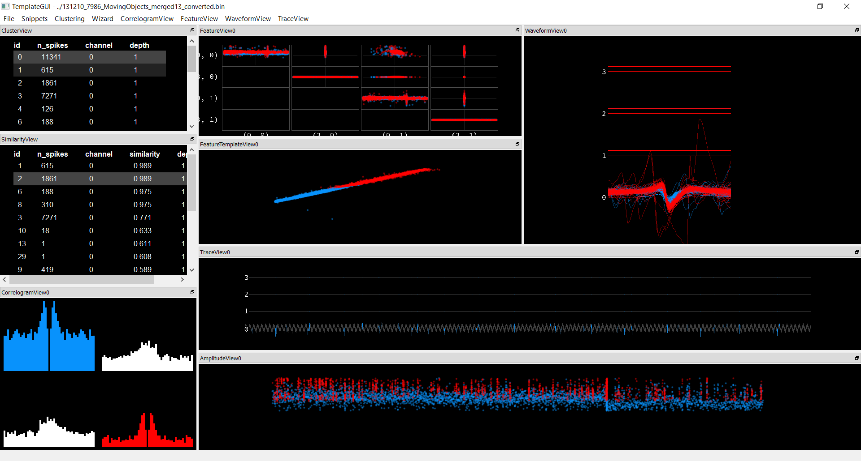
Notes:
Merge Example p2
Using WaveformView > Overlap Waveforms

